Slide 1
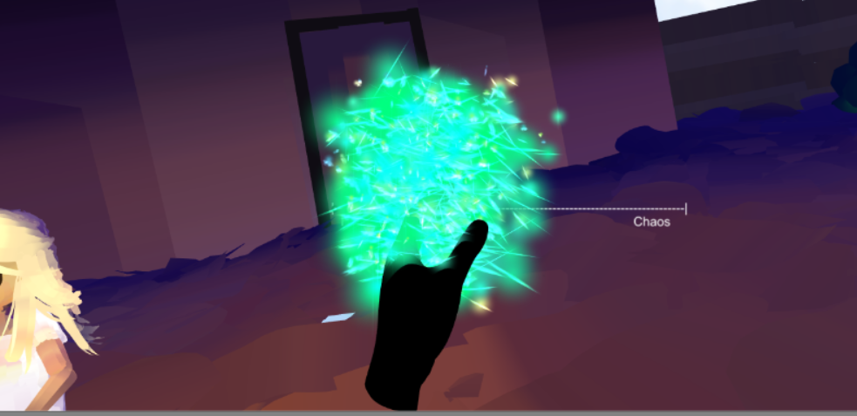
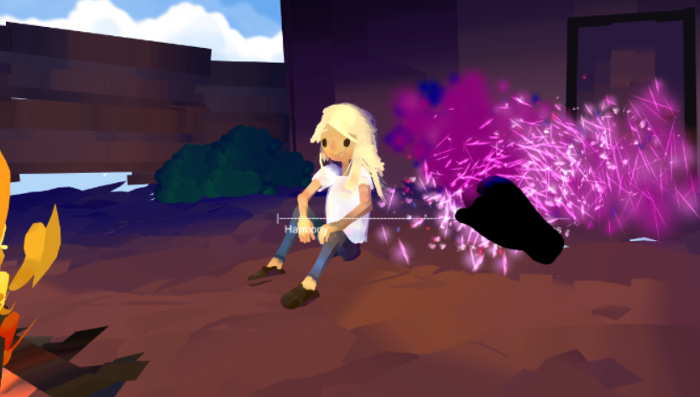
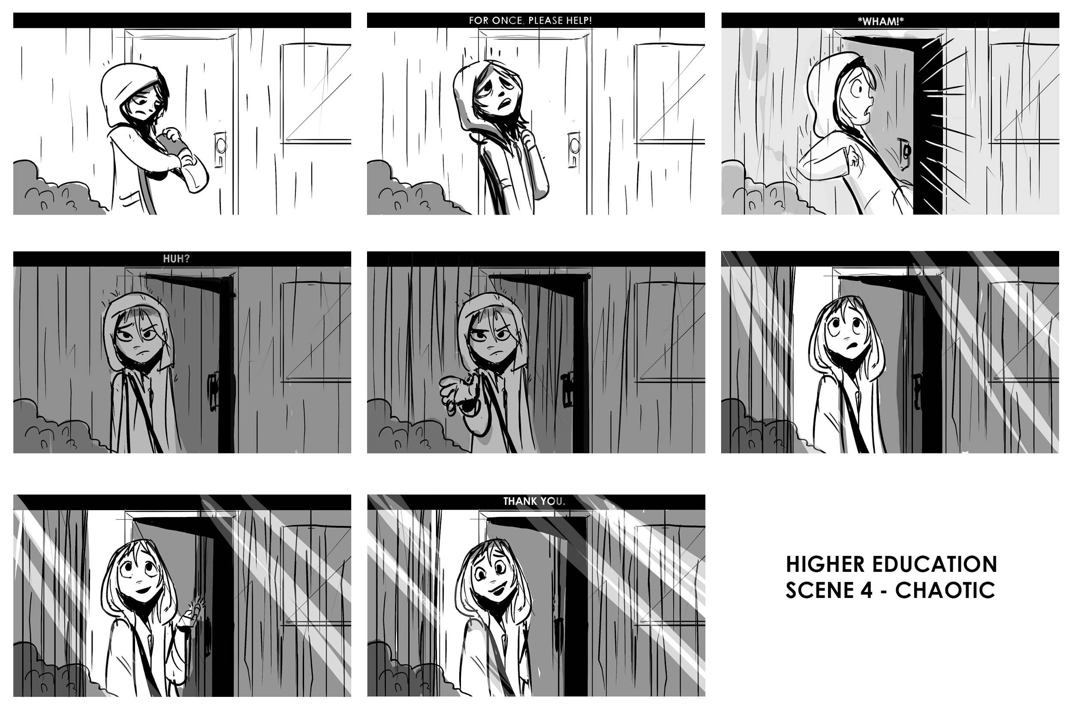
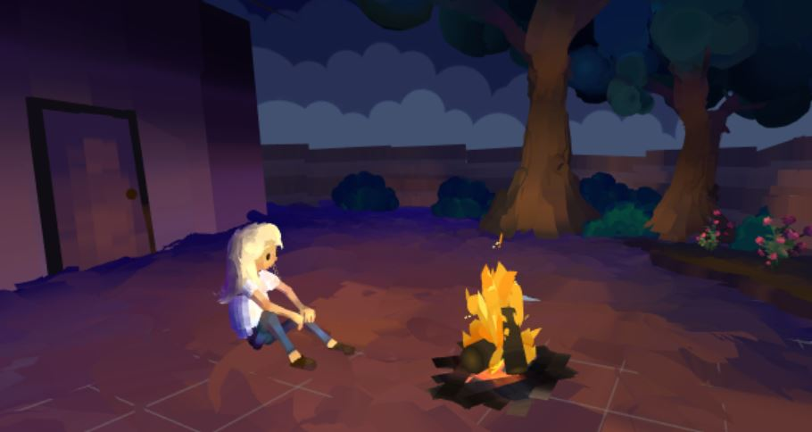
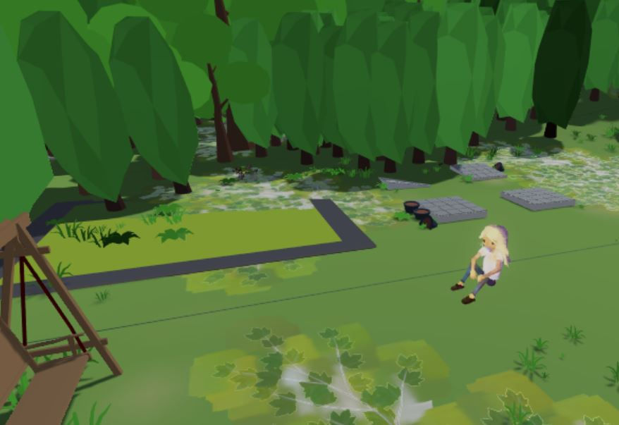

HIGHER EDUCATION VR
Allisah Solorio, Archana Senthilkumar, Brayden Decker
Conner Ward, Jackson Greaves, Jeffrey Araki, Yihui Liu
SUMMARY
IMPLEMENTATION
The player takes on the role of a guardian angel who is tasked with protecting a human charge named Amanda. The player guides Amanda through a turbulent time in her life by subtly manipulating the mood and emotional state of the environment with gesture controls.
DESIGN
Players create harmonious and chaotic states by waving their arms in a conducting motion. These states are represented in-game through the color and amount of particles emitting from the virtual representation of the players’ hands. Blue and green indicates Harmony while purple and white indicates Chaos.
We began our design process by examining the source material, brainstorming story ideas, and extracting potential interactions from those ideas. We then proceeded to create the script and storyboards for the experience. The music was recorded on multiple instruments to allow for dynamically increasing intensity and complexity. Amanda’s character models and all visuals in the dream sequence were created and animated in the Quill VR painting tool.
Players spend the first few minutes of the game in a dream sequence to learn the controls. They are introduced to some of Amanda’s backstory and how the conducting motions affect the mood of the scene.
HARMONY/CHAOS SYSTEM
Left Hand
Right Hand
Major Key
Intensity
Minor Key
Bright Scheme
Dark Scheme
Calm Weather
Intense Weather
Harmony
Inaction
Chaos
The intensity of the weather, color palette, and music becomes continuously more chaotic if the right hand is moving and continuously more harmonious if the left hand is moving. The differences between Chaos and Harmony can be seen in the above figure. We designed the system to allow for continuous input rather than discrete decision points present in other games.
The bulk of the story takes place in Amanda’s garden. Players are offered complete freedom to decide the levels of Chaos and Harmony which dynamically affect the look and sound of the scene.

